Slide 1

HR DATA ANALYSIS

Slide 2

PROBLEM STATEMENT
Working performance.
Sick leave.
Attendance level.
Overall performance of an employee.

Slide 3

OBJECTIVE
Design a interactive dashboard on Power BI dashboard for the HR team, including working hours, attendance, performance, and levels.
So that the hr team make decision.

Slide 4
DATASET ATTRIBUTES
Employee_Code
Name
Date
Value

Slide 5
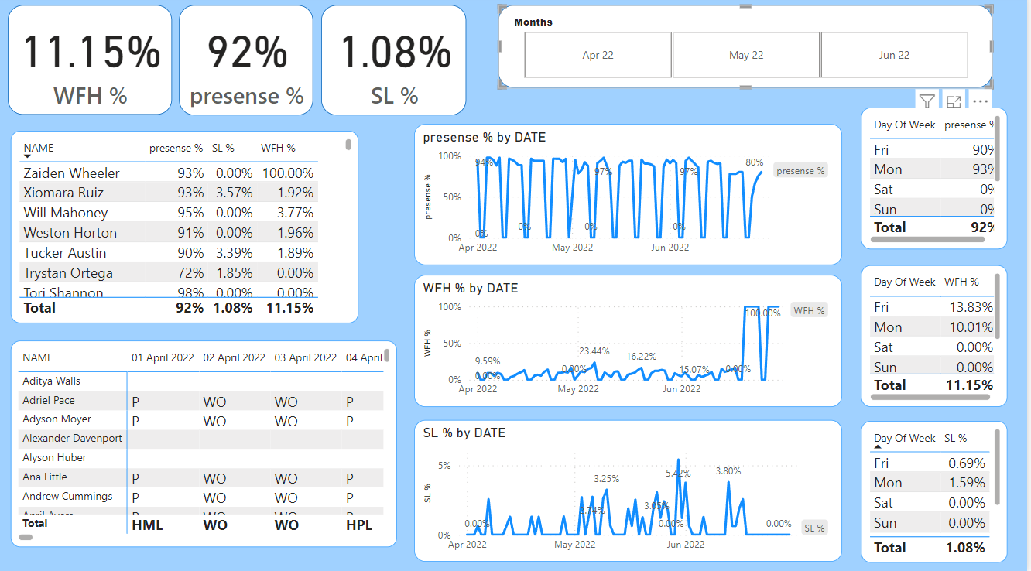
DASHBOARD

Slide 6
INSIGHTS
Work from home percentage is 11.15%.
Presence percentage is 92%.
Sick leave percentage is 1.08%.
Friday having the low presence.
Thursday and Friday having high work from home.
Monday having the high sick leaves.

Slide 7

THANK YOU

